Slide 1
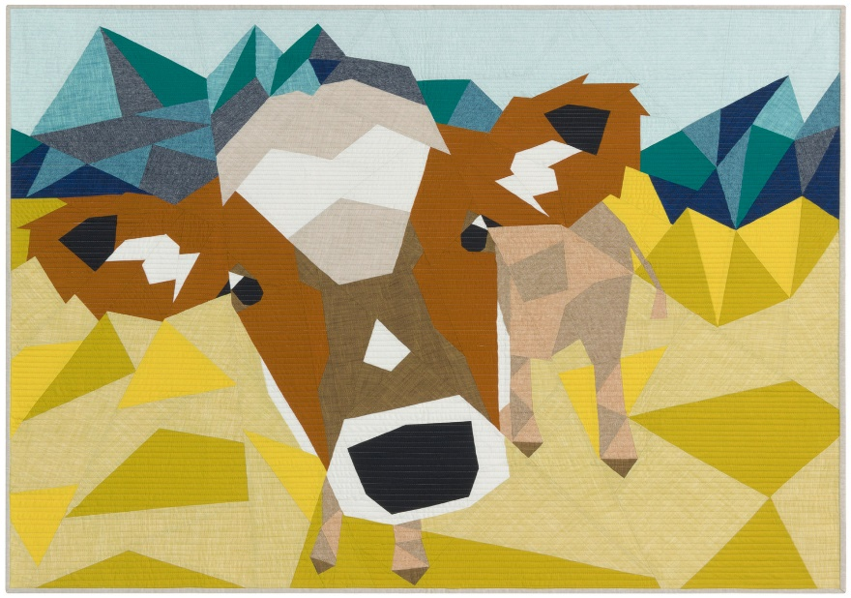
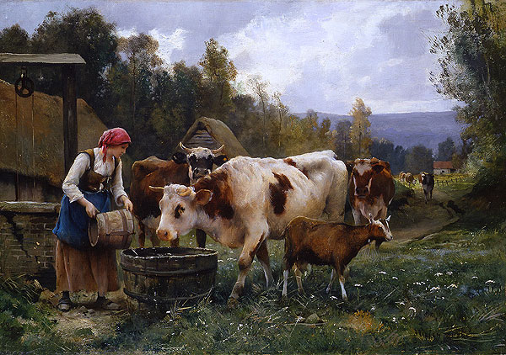
Introduction to R Programming and Collaborative Science
MPM 200 · WEEK 3
Pranav Pandit, BVSc & AH, MPVM, PhD
Department of Population Health and Reproduction
UC Davis Weill School of Veterinary Medicine

Slide 2



Learning objectives
Introduction to R programming
Project management
Collaborative and reproducible science
Basics of R syntax and data types
Setting up Google Colab and your coding environment
Best practices for collaborative research and reproducibility

Slide 3
Today's game plan
1
2
3
Lecture
R Quest (live demo)
Assignment
Why data management and reproducibility matter, and how to do them
Introduction to R.ipynb in Colab: 6 levels and a boss level, ending with an epi curve
Will the Hummers Survive? Rescue records from California wildlife rehab centers
Before the demo: open the notebook from the course GitHub with the Open in Colab badge and switch the runtime to R.

Slide 4

Data is valuable
Great effort goes into collecting data systematically.
Hard work, meticulous planning and resources go into every dataset: field teams, permits, lab time, funding.
Losing, corrupting or being unable to re-use data wastes all of that effort.

Slide 5
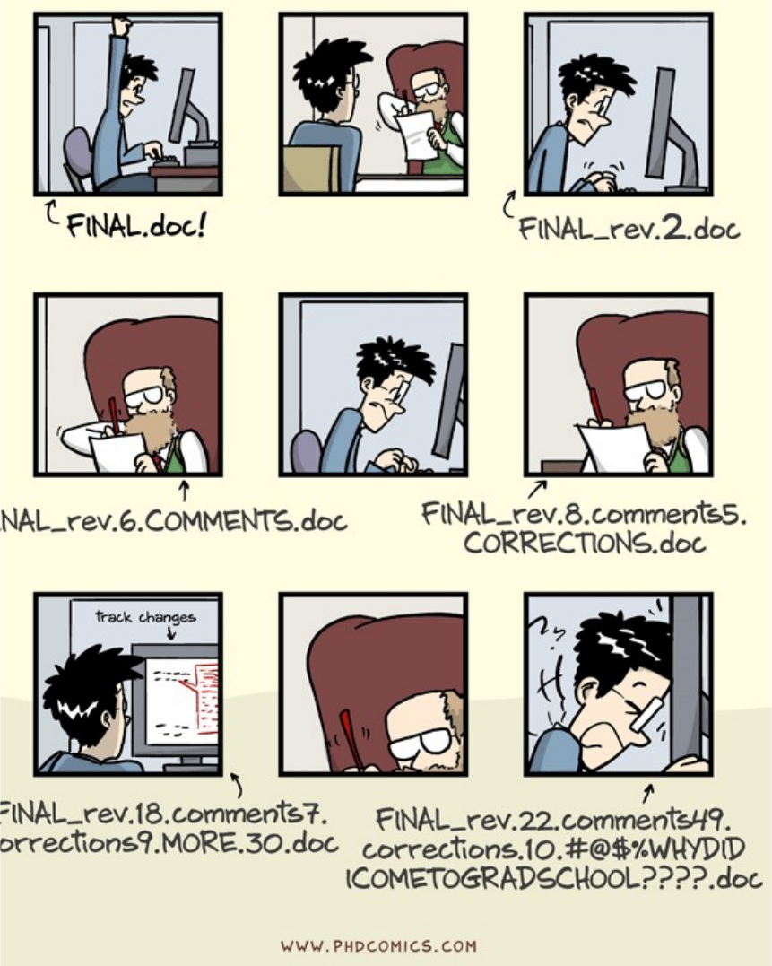


Why data management?
Safe storage and sharing
Data that survive a broken laptop, a graduate, and a reviewer's request.
Reproducible research
Anyone, including future you, can re-run the analysis and get the same answer.
Alston JM & Rick JA (2021). A beginner's guide to conducting reproducible research. Bull Ecol Soc Am 102(2):e01801.

Slide 6




Five habits of good data management
Organize
Protect
Name
Track
Back up
your project folder
your raw data
your files effectively
your project's changes
your project
The next slides take these one at a time.

Slide 7
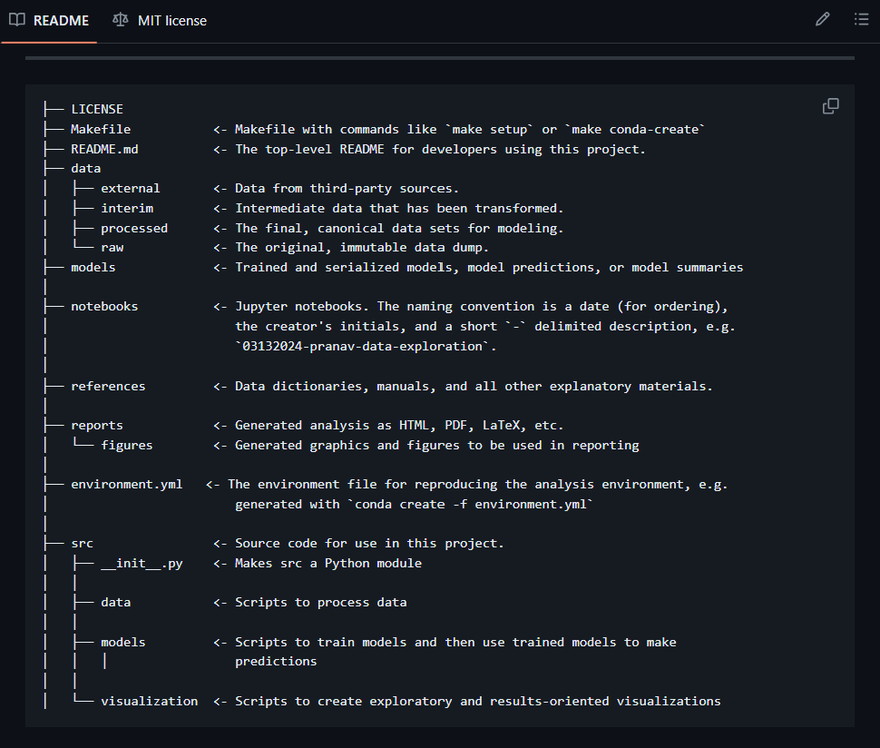
Anatomy of a working directory
1
Start every project in its own folder
In RStudio, an .Rproj file; in Colab, a project folder you create.
2
Keep raw data immutable
Never overwrite it. Clean copies go in a separate folder.
3
Modularize code by task
One notebook or script per job: cleaning, analysis, figures.
4
Store outputs separately
Plots and summaries go in outputs/, never next to raw data.

Slide 8
Naming files
No spaces
Order with prefixes
Date or version it
Use snake_case or kebab-case
01_, 02_, 03_ for sequential steps
YYYYMMDD sorts correctly; or v1.0
Examples
Why bother?
Files sort themselves in order, computers can read them, and you can tell what each one is in 6 months.
20251020_west_nile_cleaning.R
✓
bird_migration_2024_raw.csv
✓
Final data (2) NEW.xlsx
✗

Slide 9
Naming objects in R
Pick one style and stick to it
Descriptive
Consistent
camelCase
totalCases
snake_case
total_cases
Embed meaning in the name
Human readable
Machine readable
_df
data frames, e.g. covid_df
_mat
matrices, e.g. contact_mat

Slide 10



Data management and backup
Raw ≠ derived
Keep a data dictionary
Store raw and derived data in separate folders.
e.g. data_description.xlsx: what each column means and its units.
Record metadata
Back it up
Where the data came from and every processing step.
Box, Google Drive, GitHub, or rsync/Backblaze. Ideally more than one.

Slide 11



Version control your data and code
Git + GitHub
Cloud drives
External hard disk
Every change is recorded and reversible. github.com
Google Drive, Box or Dropbox: sync plus file version history.
A local copy that doesn't need the internet.
In this course: save notebooks to your own branch of the EpiPandit/MPM_200 repository. Never to main.

Slide 12
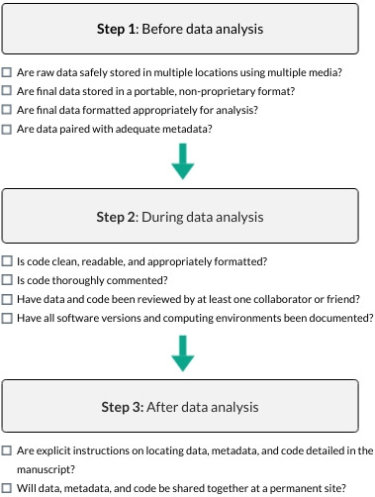
A reproducibility checklist
1
Before analysis
Raw data backed up in several places, in open formats, with metadata.
2
During analysis
Code clean, commented, reviewed by a colleague; software versions documented.
3
After analysis
Clear instructions to find data and code; shared together at a permanent site.
Figure: Alston JM & Rick JA (2021). Bull Ecol Soc Am 102(2):e01801. doi:10.1002/bes2.1801
Notes:
A 10-point checklist to guide researchers toward greater reproducibility in their research. Researchers should give careful thought before, during, and after analysis to ensure reproducibility of their work.
IF THIS IMAGE HAS BEEN PROVIDED BY OR IS OWNED BY A THIRD PARTY, AS INDICATED IN THE CAPTION LINE, THEN FURTHER PERMISSION MAY BE NEEDED BEFORE ANY FURTHER USE. PLEASE CONTACT WILEY'S PERMISSIONS DEPARTMENT ON PERMISSIONS@WILEY.COM OR USE THE RIGHTSLINK SERVICE BY CLICKING ON THE 'REQUEST PERMISSIONS' LINK ACCOMPANYING THIS ARTICLE. WILEY OR AUTHOR OWNED IMAGES MAY BE USED FOR NON-COMMERCIAL PURPOSES, SUBJECT TO PROPER CITATION OF THE ARTICLE, AUTHOR, AND PUBLISHER.

Slide 13

Your coding environment: Google Colab
R in the browser. Nothing to install, easy to share.

Slide 14
Get R running in Colab in five steps
1
2
3
4
5
Sign in
Open the notebook
Switch to R
Load packages
Save your work
Go to Google Colab with your UC Davis Google account
Click Open in Colab on the course GitHub, or File → New notebook in Drive
Runtime → Change runtime type → R. Leave hardware on CPU.
install.packages() and library() at the start of every session
File → Save a copy in GitHub, to your own branch. Date-stamp the file name.
Full walkthrough: Google Colab Setup Instructions.pdf on the course GitHub

Slide 15



Colab gotchas (save yourself an hour)
Colab forgets
You live in /content
Packages, uploaded files and objects vanish when the runtime disconnects. Re-run from the top.
Paths from someone else's laptop (setwd("C:/Users/...")) will always fail. Use relative paths.
beep() is silent
Never save to main
beep() runs on Google's machine. The assignment includes a helper that plays sound in your browser.
Save a copy in GitHub to your own branch. Main belongs to the instructors.

Slide 16
Live demo: R Quest
Introduction to R.ipynb · You're a new epidemiologist in August 2020 with five months of state COVID-19 reports to explain by Friday.
0
Level 0 · Set up Colab
4
Level 4 · Meet the data, plus a bug hunt
1
Level 1 · R as a calculator: objects, data types, vectors
5
Level 5 · Wrangle with dplyr
2
Level 2 · Packages (and a talking cow)
6
Level 6 · Build a ggplot layer by layer
3
Level 3 · Working directory and a tidy project
★
Boss level · California's epi curve

Slide 17

Your mission: Will the Hummers Survive?
6,908 hummingbird rescues from three California rehab centers, 1991–2016
Five case files, a data-detective bonus, and a plot hall of fame

